Slide 1
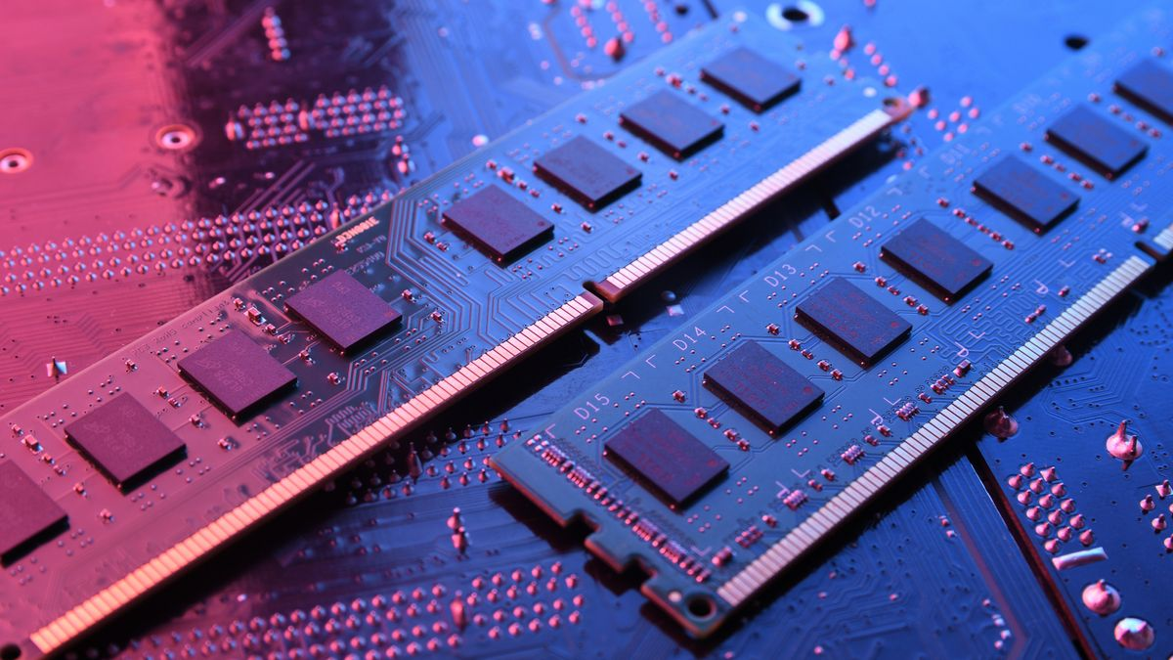
MADE BY:
SANDEEP KUMAR
SANSKAR VARSHNEY
SAPNA CHOUDHARY
SARVAGYA PANDEY

Slide 2
INTRODUCTION
Computer memory is just like the human brain .It is used to store
data/information and instructions on a temporary or permanent
basis for use in an electronic digital computer.
It is a data storage unit or a data storage device where data is to be
processed and instructions required for processing are stored.

Slide 3

COMPUTER MEMORY MEASUREMENT
Bit Smallest unit of computer memory
Byte
-8 bit = 1 byte
Kilobyte
1024 byte = 1KB
Megabyte
1024 kb = 1MB
Gigabyte
1024 MB = 1GB
Terabyte
1024 GB = 1TB

Slide 4
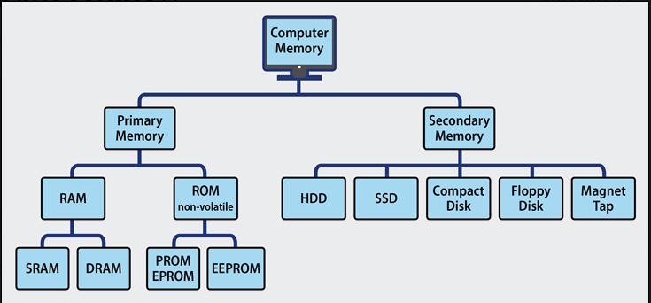
CLASSIFICATION OF MEMORY

Slide 5
PRIMARY MEMORY
Primary memory also known as main memory . It is relatively large memory placed outside the processor.
It is the working memory of the computer.
It can be accessed directly and rapidly by the CPU.
It is a volatile memory and faster memory than secondary memory.
EXAMPLE : RAM,ROM

Slide 6
TYPES OF PRIMARY MEMORY
RAM
ROM

Slide 7
RANDOM ACCESS MEMORY
RAM is a type of memory that is used to temporarily store data.
It is also called read-write memory.
Volatile memory.
Every location can be accessed independently.
Data is lost when the power is turned off.
TYPES OF RAM
STATIC
RAM
DYANMIC
RAM

Slide 8
DYNAMIC RAM
DRAM Stands for Dynamic Memory.
It is used for main memory.
It has high power consumption.
It is slower memory in comparison to SRAM.
It is less costly.
Access time 60-70 nanoseconds.

Slide 9
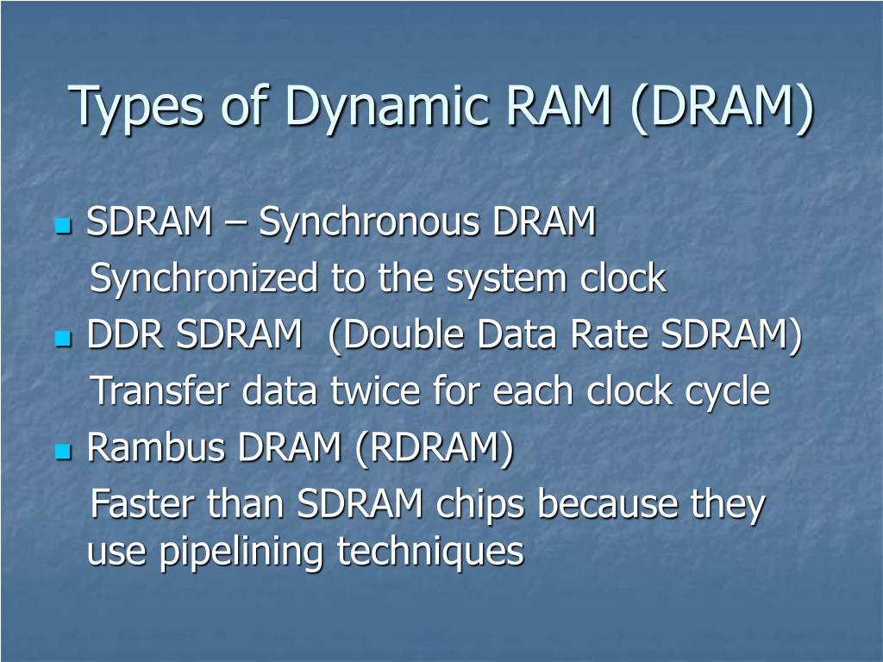
TYPES OF DYNAMIC RAM

Slide 10
STATIC RAM
SRAM stands for static RAM.
Characterized by high speed and high cost.
It has larger storage.
It takes less power to perform.
Use six transistors to store data.
Can accept one command and transfer one word of data per clock cycle.

Slide 11
READ ONLY MEMORY (ROM)
ROM stands for read only memory.
A class of storage used in computer and other electronic devices.
Data stored in it can not be modified.
It is a non-volatile memory.
Information stored in it is permanent.
It is used to store important information which is used to operate the system.
EXAMPLE : Hard disks,DVD drives etc.

Slide 12
TYPES OF ROM
PROM
FLASH
ROM
EPROM
EEPROM

Slide 13
SECONDARY MEMORY
Much larger in capacity but slower than main memory.
Permanent storage of data and instruction.
It is a non-volatile memory.
The data and information saved inside secondary storage devices can be retrieved anytime users request or demand.
They are portable.
EXAMPLE : Hard disk , CD, Floppy etc.

Slide 14
CACHE MEMORY
It acts buffer between CPU and main memory (RAM).
Cache is high speed memory for holding recently accessed data in main memory.
It provides faster access.
Cache memory allows CPU to operate at a higher effective speed .
Enhancing system scalability.

Slide 15
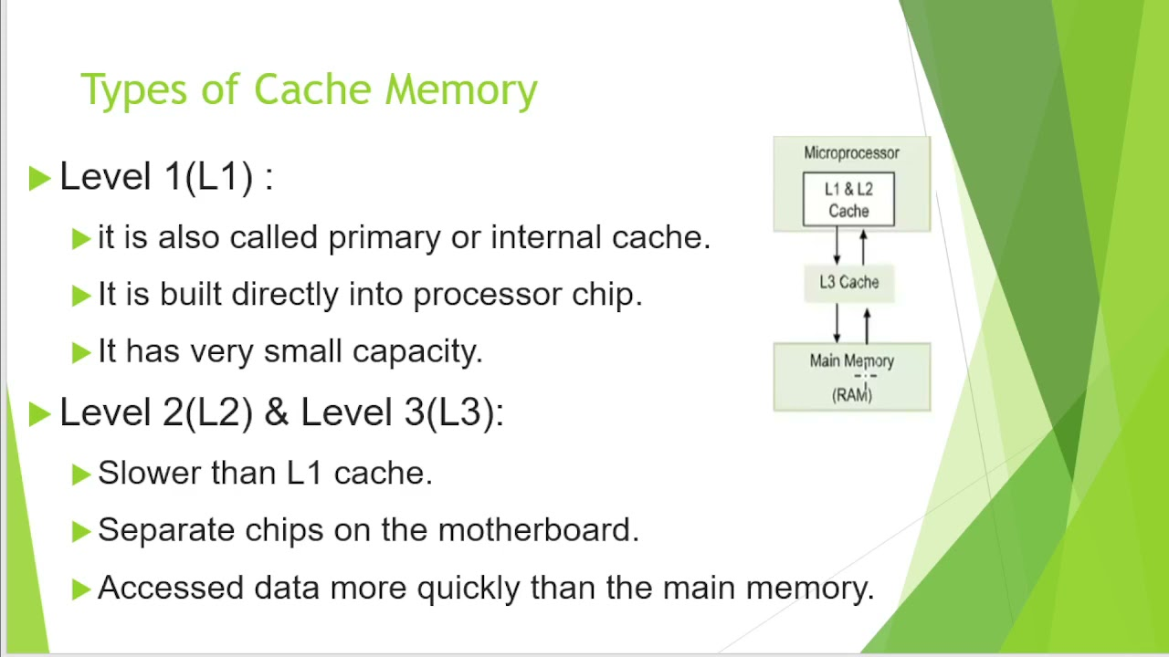
TYPES OF CACHE

Slide 16
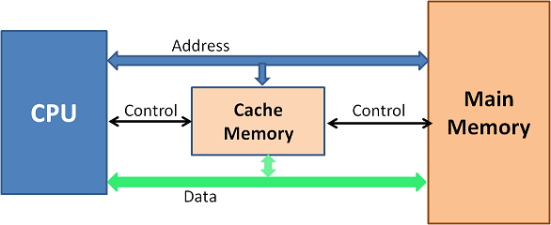
OPERATION OF CACHE MEMORY

Slide 17
REGISTER
Register memory is the smallest and fastest memory in a computer.
It is located in the CPU .
A register temporarily holds frequently used data, instructions, and memory address that are used by the CPU.
EXAMPLE : Data register, program counter etc.

Slide 18
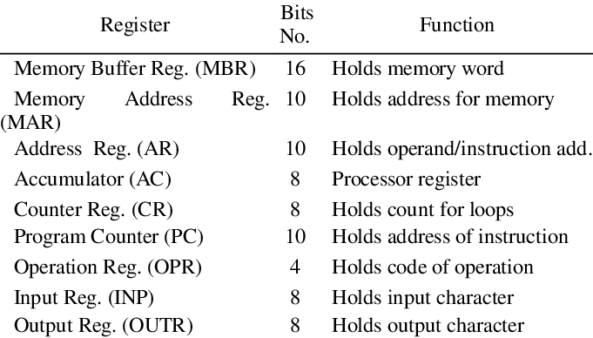
TYPES OF REGISTER

Slide 19
MEMORY HIERARCHY
The memory hierarchy concept is used to discuss performance issues in computer architectural design, algorithms predictions, and lower level programming constructs.
The memory hierarchy in computer storage separates each of its level based on response system.

Slide 20
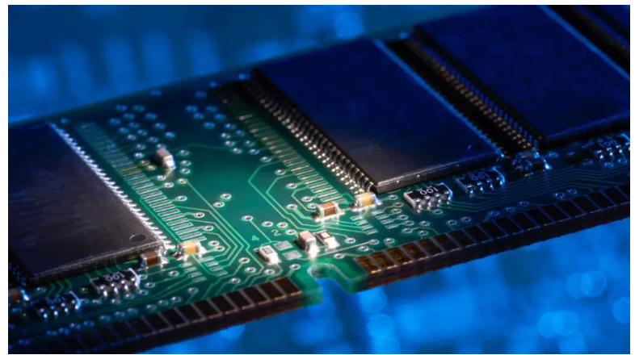
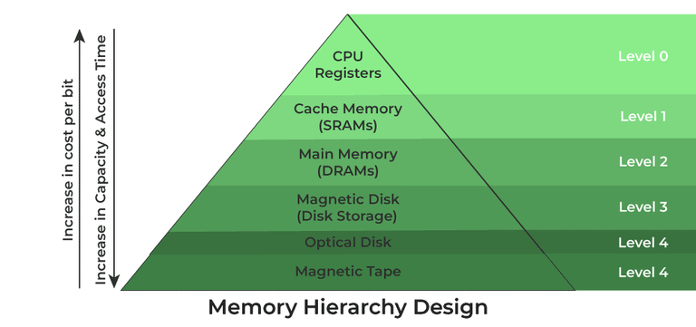

Slide 21
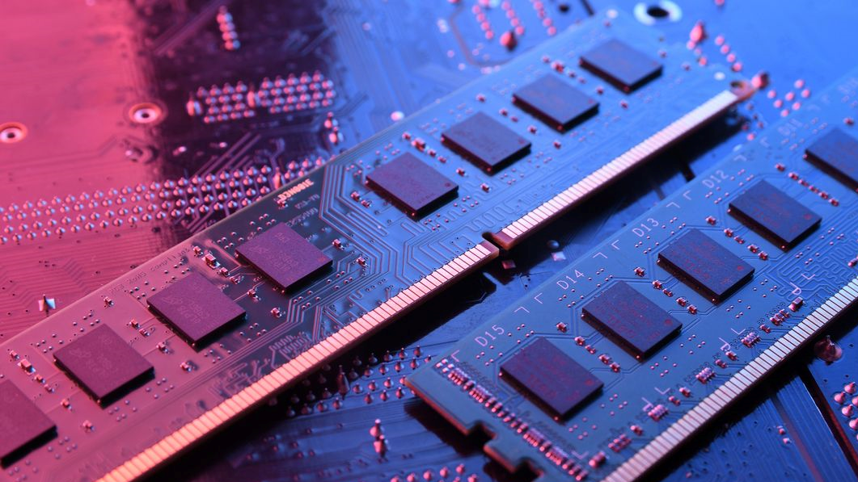
CONCLUSION
Understanding the different types and functions of memory in computers is fundamental to grasping the inner workings of computer systems. Memory management is crucial for optimal performance and efficient data processing.
- Memory is an important part of computer .
-Without memory, probably a computer is of no use in a greater sense .

Slide 22
The End
Thank You

